Slide 1
Summary of My Semester
DefED-Net: Deformable Encoder-Decoder Network for Liver and Liver-Tumor Segmentation
Artificial Intelligence and Machine Vision Lab
2B519
Su Jian
2020.12.28

Slide 2
Contents
1
Backgrounds
2
Related work
3
Method
4
Conclusion

Slide 3
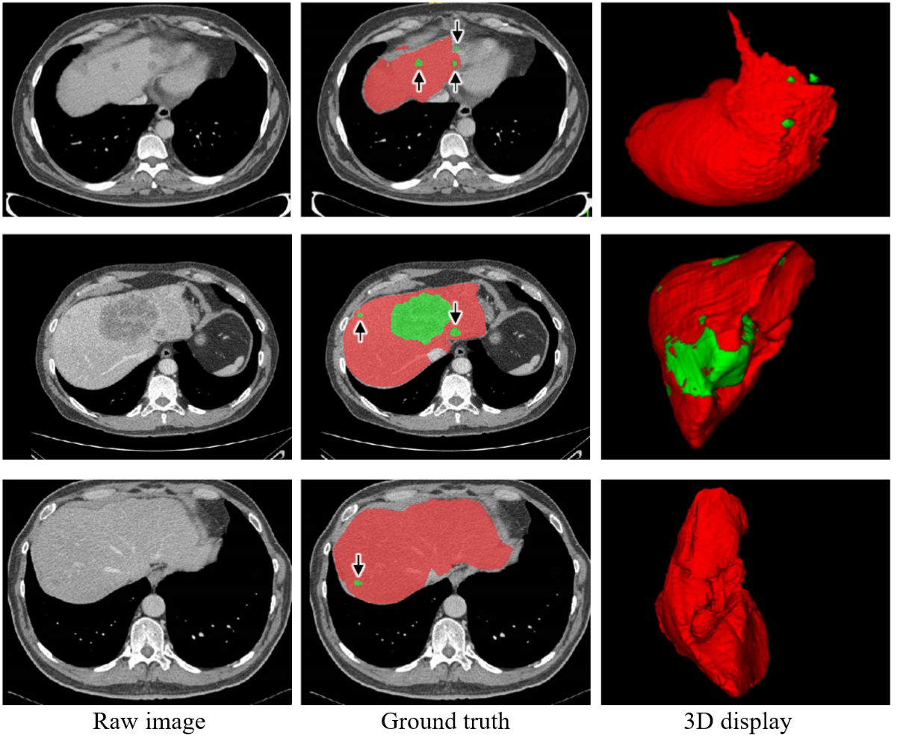
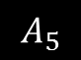
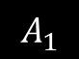
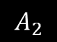
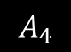
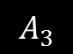
Liver and Tumor Segmentation
Challenges:
The size, shape, and location are complex and vary from person to person
The tumor edge is blurred and may be adjacent to other organs and blood vessels
They are exhibit grayscale values similar to that of neighboring organs
There are pathological changes
The current neural network model has a large number of parameters and low robustness
$$A_{4}$$
$$A_{1}$$
$$A_{3}$$
$$A_{2}$$
$$A_{5}$$
Opportunities:
Deep learning techniques are rapidly developing
We are in the era of big data in healthcare
Clear anatomical contextual information from abdominal CT
The powerful computing capability can be provided

Slide 4
Contents
1
Backgrounds
2
Related work
3
Method
4
Conclusion

Slide 5
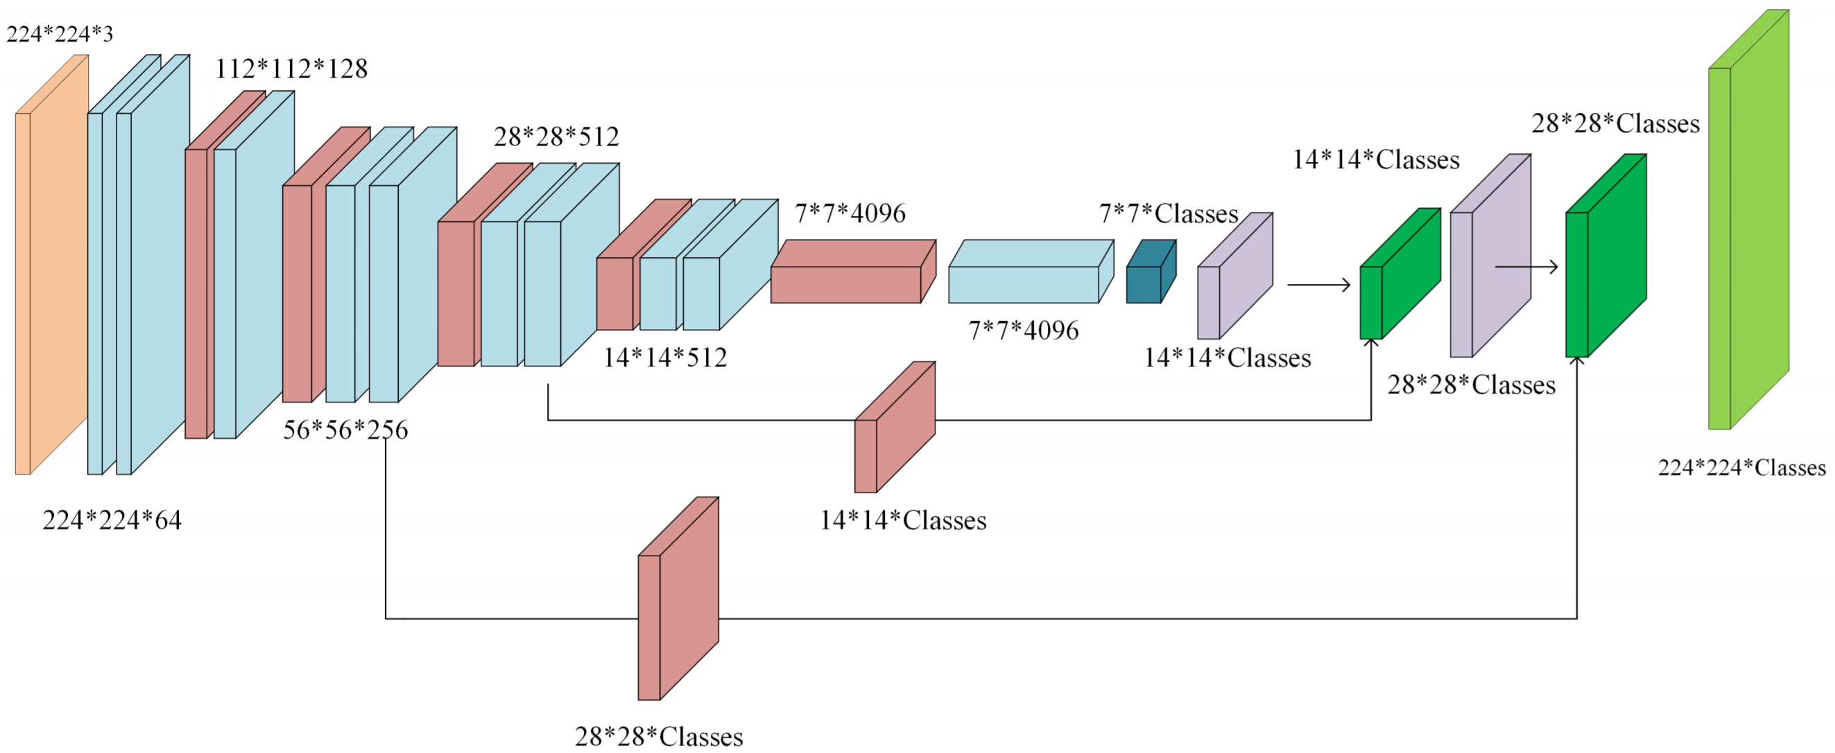
FCN (Fully Convolutional Networks)
The encoder consists of 4 pooling layers and 9 convolutional layers;
The decoder consists of 3 deconvolutional layers.
Disadvantages:
The decoder is too coarse.
Feature fusion uses the way of adding.
Backbone network is VGG16/19 leading to large memory usage.
Advantages:
FCN firstly presents the idea of encoder-decoder, the idea is effective for image segmentation.
FCN firstly adopts fully convolution operation instead of fully connection, which improves the computational efficient.
FCN firstly adopts the idea of feature fusion of low-level and high-level features.
[1] E. Shelhamer, J. Long, T. Darrell, “Fully Convolutional Networks for Semantic Segmentation”, IEEE Trans. Pattern Anal. Mach. Intell, vol. 39, no. 4, pp. 640-651, May. 2016.

Slide 6
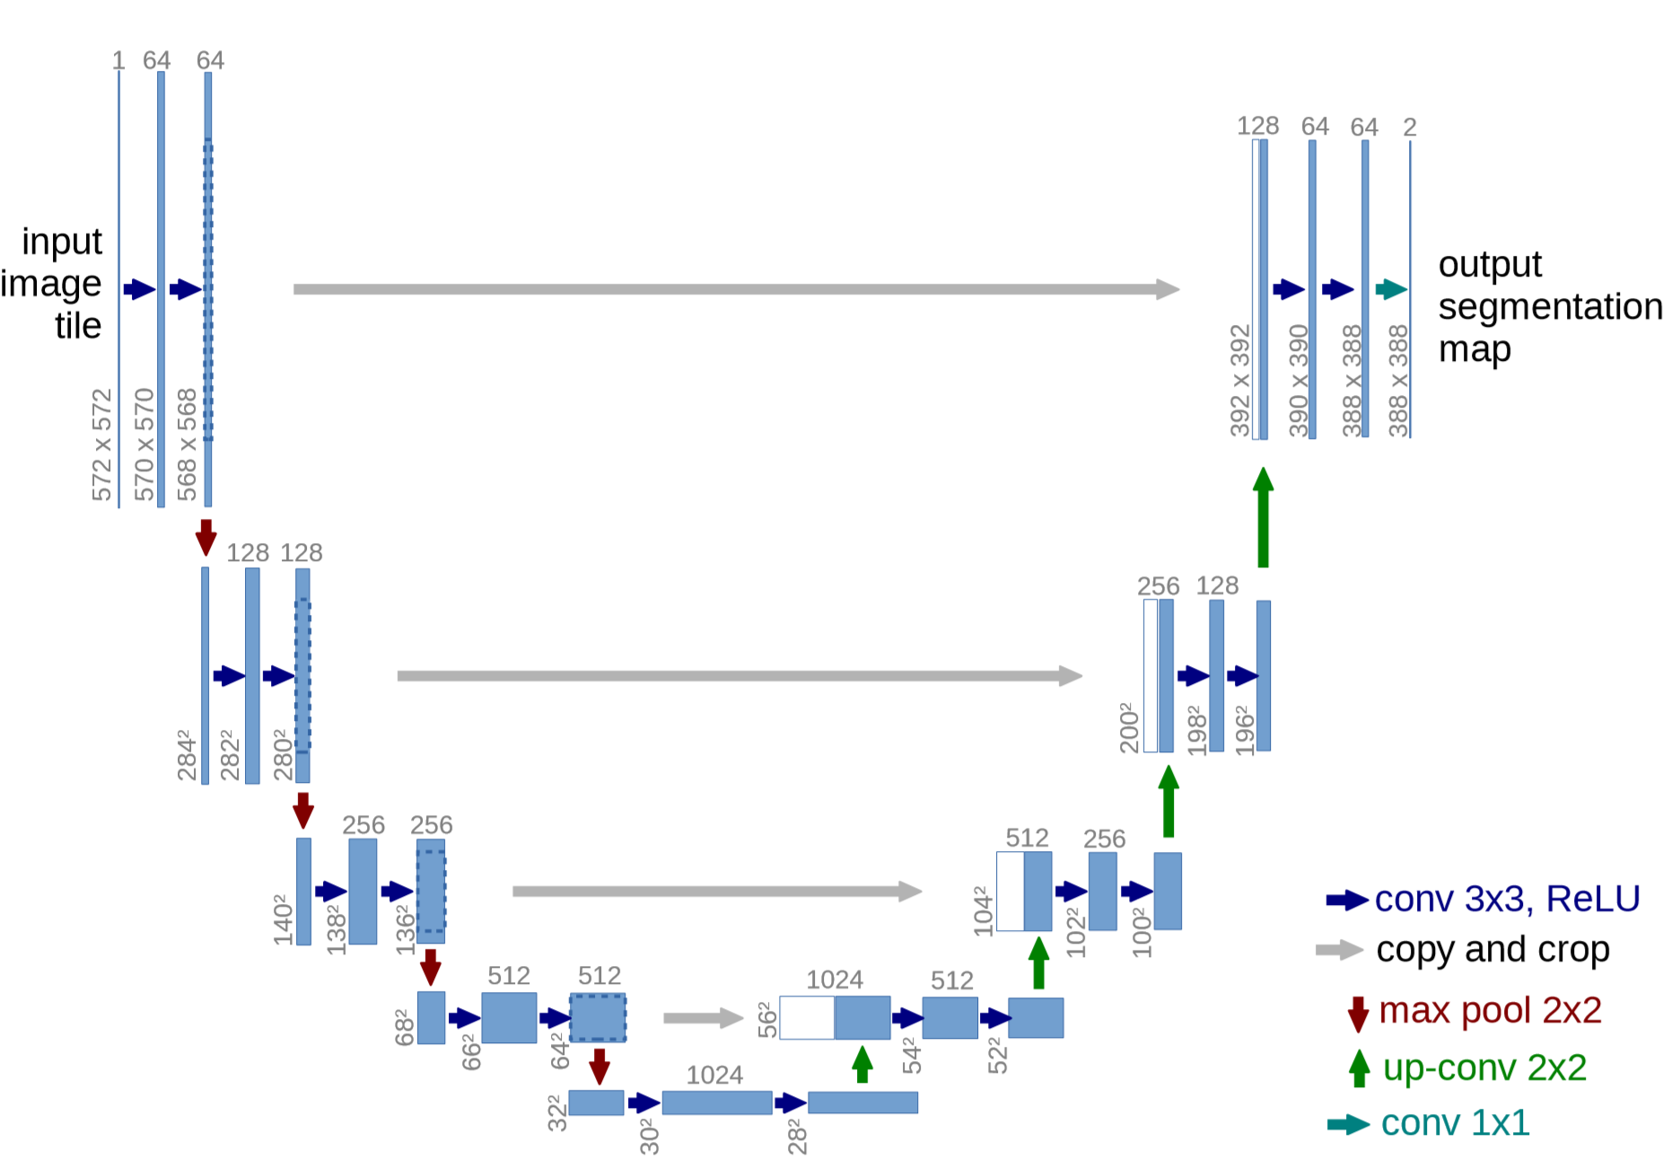
U-Net
Advantages:
A perfectly symmetric network structure.
Deconvolution+convolution can improve feature fusion.
Skip connection uses the way of concatenate.
FCN 226M vs. U-Net 51M
Less convolution kernels
4 down-sampling
8 convolutional layers
Disadvantages:
The common convolution adopts convolution kernels with fixed geometric structures.
The fixed perceptive field lose the global information
Skip connection is simple and can be improved.
The model size is large
[1] Ronneberger, P. Fischer, and T. Brox, “U-net: Convolutional networks for biomedical image segmentation,” Proc. Int. Conf. Med. Image Comput. Comput. Assist. Intervent. (MICCAI) , pp. 234–241, 2015.

Slide 7
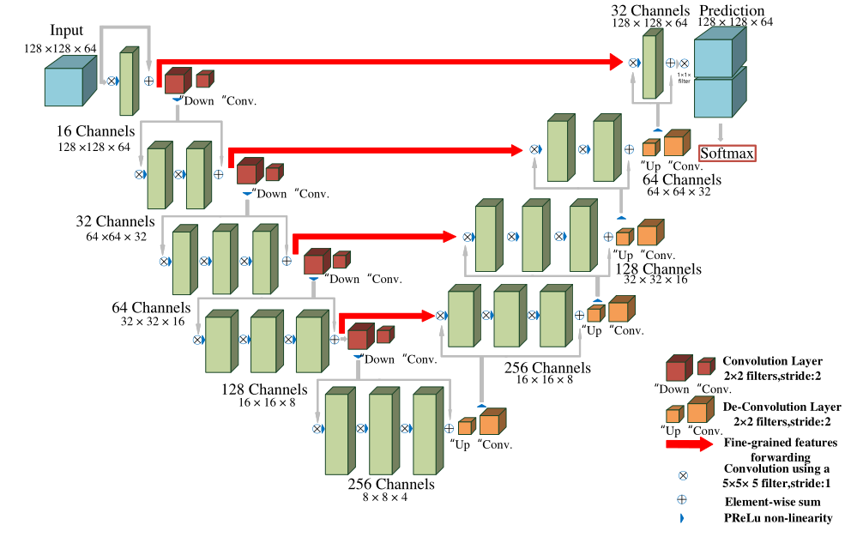
V-Net
Advantages:
3D convolution kernels are employed to extract context information of 3D space.
Residual structure is adopted in the V-Net.
Disadvantages:
The size of the network is huge due to a large number of parameters.
It requires large number of hardware resources.
[1] F. Milletari, N. Navab, and S. A. Ahmadi, “V-net: Fully convolutional neural networks for volumetric medical image segmentation,” Conf. 3D Vis. (3DV) , pp. 565-571, 2016.

Slide 8
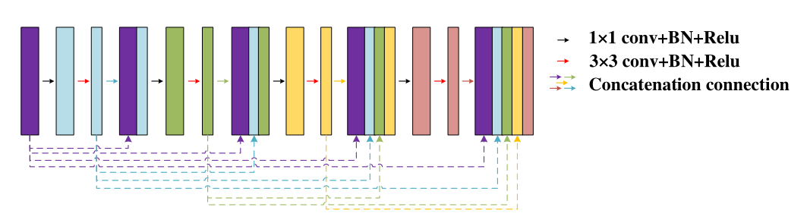
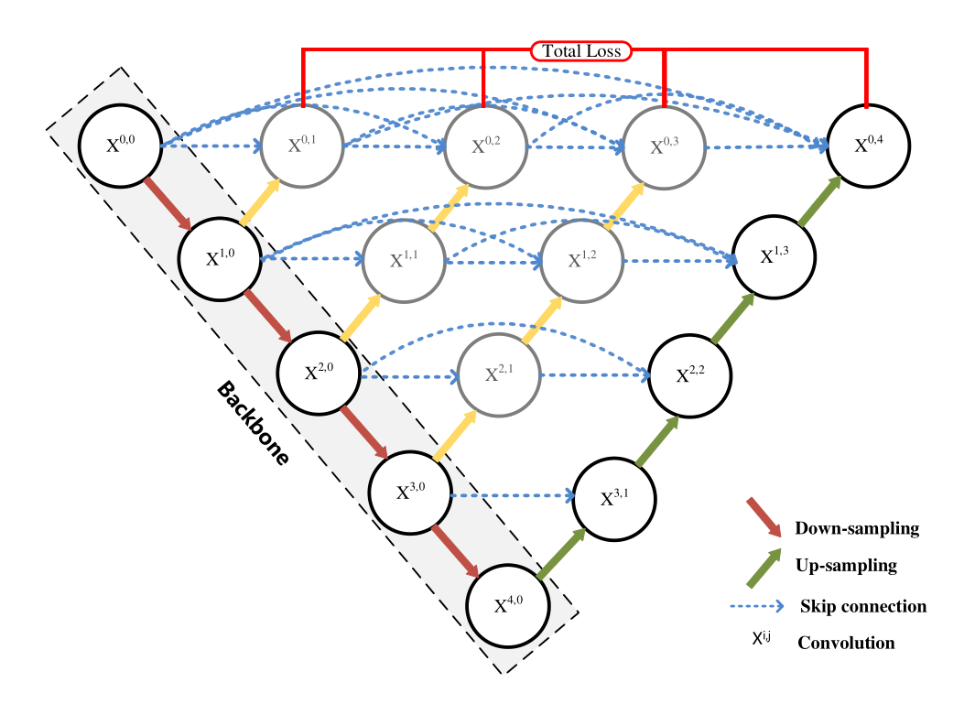
Dense U-Net & U-Net++ (Dense Connection Net)
Advantages:
Dense connection employs “concat” that achieves feature reuse.
Dense connection employing bottleneck module to reduce the dimension of feature maps.
Dense connection has a low computational complex since the former is trained easily and achieves convergence fast.
Dense connection achieves a hidden depth supervision due to the error is directly input into each layer
Disadvantages:
It often reduces the robustness of feature representation to a certain extent and increases the number of parameters.
[1] S. Guan, A. Khan, S. Sikdar, and P . Chitnis, “Fully dense UNet for 2D sparse photoacoustic tomography artifact removal,” IEEE J. Biomed. Health. Inform., 2019.
[2] Z. Zhou, M. M. R. Siddiquee, N. Tajbakhsh, and J. Liang, “UNet++: Redesigning skip connections to exploit multiscale features in image segmentation,” IEEE Trans. Med. Imag., 2019.
Notes:
1.特征提取块：采用的是添加了空洞卷积的ResNet网络，空洞卷积的作用，主要是增大感受野，提取到的特征作为后面pyramid pooling模块的输入。
2.金字塔池化：在pyramid pooling模块中构建了深度为4的特征金字塔，不同深度的特征是基于输入特征通过不同尺度的池化操作得到的，池化的尺度是可以调整的，这篇文章中给出的池化后的特征尺寸分别是1、2、3和6。然后通过一个1*1卷积层将特征维度缩减为原来的1/4，最后将这些金字塔特征直接上采样到与输入特征相同尺寸，然后和输入特征做合并，也就是concat操作得到最终输出的特征图。特征合并的过程其实就是融合目标的细节特征（浅层特征）和全局特征（深层特征，也就是上下文信息）的过程，这里因为特征提取网络最后输出的特征层感受野足够大，所以有足够的全局信息。

Slide 9
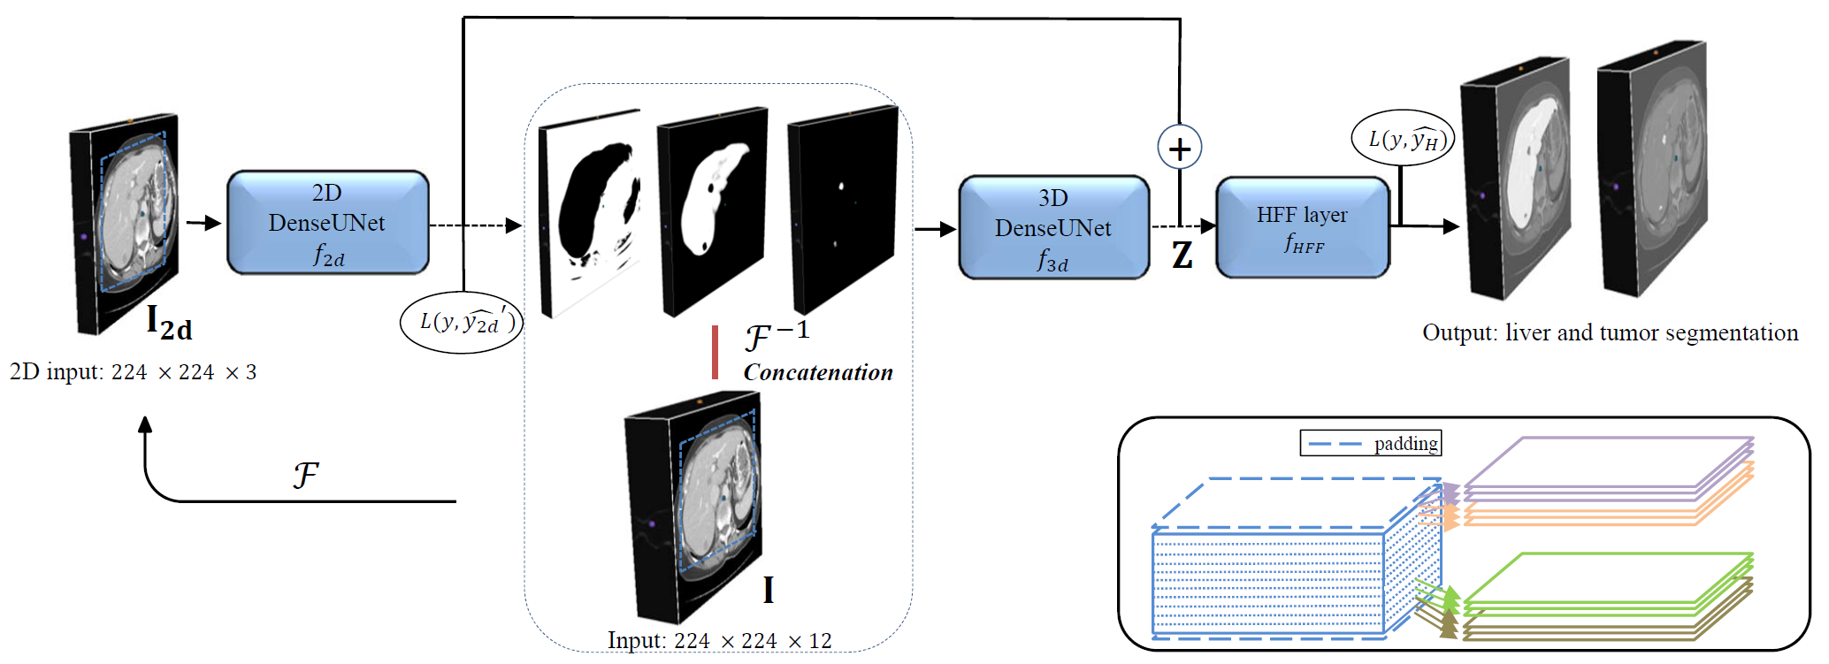
H-DenseUnet
Advantages:
2D+3D stronger feature learning capability.
Densely connected on U-Net.
It converges quickly.
Disadvantages:
The network structure is complex, and the training process is very difficult.
The champion in the challenge of MICCAI2017.
[1] X. Li, H. Chen, X. Qi, Q. Dou, C. Fu, P. Heng, “H-DenseUNet: Hybrid Densely Connected UNet for Liver and Tumor Segmentation From CT Volumes”, IEEE Trans. Med. Imag., vol. 37, no. 12, pp. 2663-2674, Dec. 2018.
Notes:
文中说需要单独训练一个类ResNet网络（不属于H-DenseUNet的组成部分）专门用于在CT体数据中确定肝脏的大致范围，再将这个范围区间内的切片取出，用于H-DenseUNet的学习或者推理。

Slide 10
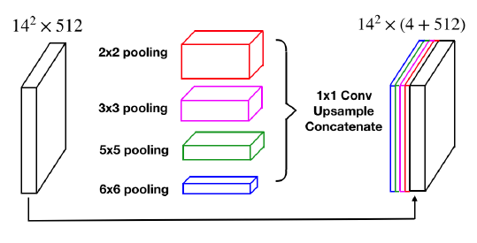
CE-Net (Multi-scale Information Fusion）
Why we need multi-scale?
One of the challenges in medical image segmentation is a large range of scales among objects. For example, a tumor in the middle or late stage could be much larger than that in the early stage.
Compared traditional machine learning, deep leaning can provide richer semantic information and thus deep-layer features are more useful than shallow-layer feature, which is the reason that feature fusion is performed at deep layers
Advantages:
Multi-scale feature extraction is a popular in traditional machine learning, feature concatenate will lead to high feature dimension while feature adding leads to weighted feature combination.
Pyramid pooling is used for feature fusion and the global feature is used effectively.
Disadvantages:
The operation of pooling lose the detailed information.
[1] K. He, X. Zhang, S. Ren, and J. Sun, “ Spatial pyramid pooling in deep convolutional networks for visual Recognitition,” IEEE Trans. Pattern Anal. Mach. Intell., vol. 37, no. 9, pp. 1904-1916, 2015.
[2] Zhao, Hengshuang, et al. "Pyramid scene parsing network." Proceedings of the IEEE CVPR. 2017.
[3] Z. Gu, J. Cheng, H. Fu, K. Zhou, H. Hao, Y . Zhao, et al., “CE-Net: context encoder network for 2D medical image segmentation,” IEEE Trans. Med. Imag., vol. 38, no. 10, pp. 2281-2292, 2019.
Notes:
为什么我们需要多尺度？
医学图像分割的挑战之一是对象之间的尺度范围很大。例如，一个处于中晚期的肿瘤可能比早期的肿瘤大很多。
与传统的机器学习相比，深度精益可以提供更丰富的语义信息，因此深层特征比浅层特征更有用，这也是在深层进行特征融合的原因所在
何凯明首次引入金字塔池化在图像分割中，利用多尺度池化层来获取不同尺度的信息，并进行整合，随后被引入医学图像分割中，但实际上我们知道池化操作会导致upsample无法还原由于pooling导致的一些细节信息的损失，因此自然需要移除池化层，

Slide 11
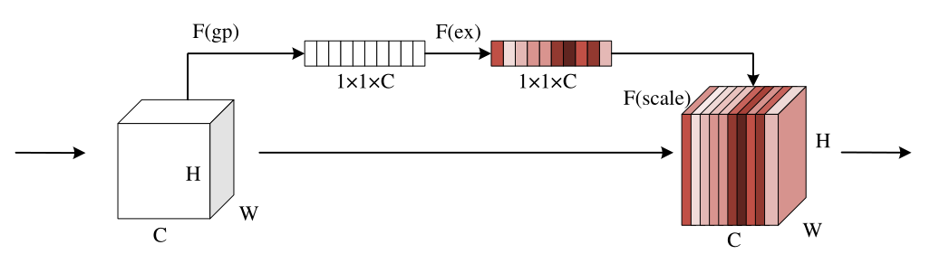
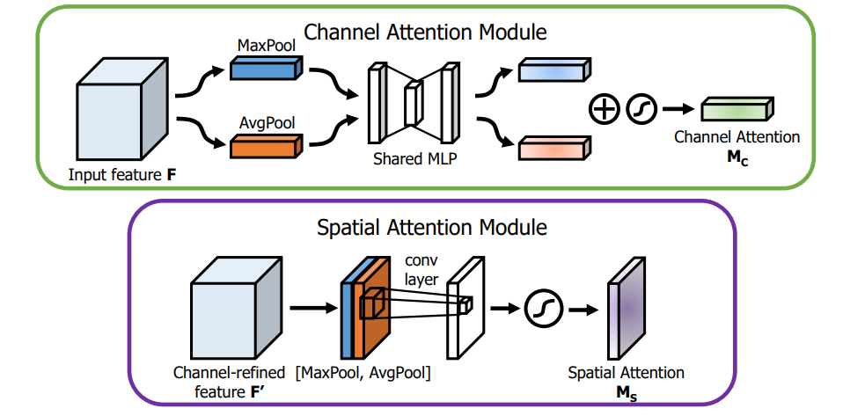
Attention U-Net & FED-Net (Channel and spatial attention)
Advantages:
The attention block can selectively change input or assigns different weights to input variables according to different importance.
Channel-wise attention: Look “what”
Spatial attention: Look “where”
Disadvantages:
They only perform an operation of local convolution. The operation focuses on the area of neighboring convolution kernels but misses the global information.
[1] M. Jaderberg, K. Simonyan and A. Zisserman, “ Spatial transformer networks,” in Proc. Adv. Neural Inf. Process. Syst., 2015.
[2] O. Oktay, J. Schlemper, L. L. Folgoc, M. Lee, M. Heinrich, K. Misawa, et al., “ Attention U-Net: Learning where to look for the pancreas,” arXiv preprint arXiv:1804.03999, 2018.
[3] J. Hu, L. Shen, and G. Sun, “Squeeze-and-excitation networks,” in Proc. IEEE Conf. Comput. Vis. Pattern Recogniti., pp. 7132-7141, 2018.
[4] X. Chen, R. Zhang, and P . Yan, “ Feature fusion encoder decoder network for automatic liver lesion segmentation,” Proc. IEEE 16th Int. Symp. Biomed. Imag. (ISBI) , pp. 430-433, 2019.

Slide 12
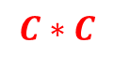
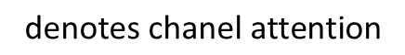
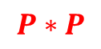
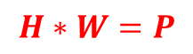
Non-local Attention
Local operation
Non-Local operation
$$H∗W=P$$
$$\text{affinity} \text{matrix} \text{denotes} \text{spatial} \text{attention} \text{that} \text{concerns} \text{all} \text{pixels}$$
$$C∗C$$
$$\text{denotes} \text{chanel} \text{attention}$$
$$P∗P$$
Local operation uses square-shaped convolutional kernels such as 3×3, 5×5, etc. to perform convolution, which considers only local regions and are therefore local operations. Conversely, non-local means that the receptive field can be large, rather than a local field.
Advantages:
Get global pixel-to-pixel long range dependencies.
increase the receptive field.
Disadvantages:
Capturing long range dependencies is too inefficient.
Require higher computing resources.
[1] Wang, Xiaolong, et al. "Non-local neural networks." Proceedings of the IEEE conference on computer vision and pattern recognition. 2018.
[2] Z. Wang, N. Zou, D. Shen, and S. Ji, “ Non-local U-Nets for biomedical image segmentation,” Proc. AAAI Conf. Artif. Intell., 2020.

Slide 13
Contents
1
Backgrounds
2
Related work
3
Method
4
Conclusion

Slide 14
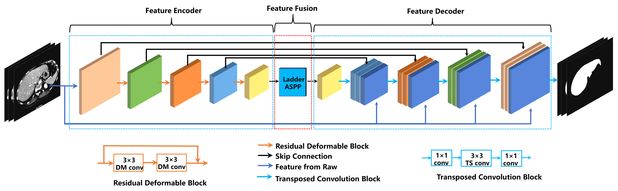
DefED-Net
Contributions:
1. Feature extraction of CT images using deformable convolution with residual connection.
2. Ladder-ASPP is presented for context information fusion.
3. Higher segmentation accuracy for networks with smaller model parameters.

Slide 15
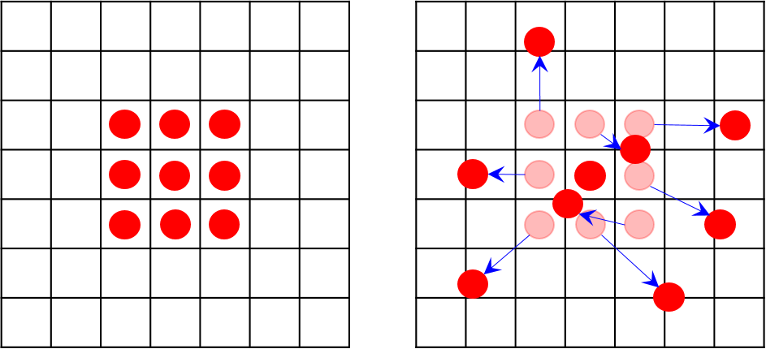
Motivation 1-Deformable convolution
Advantages: wider receptive field, adaptive spatial information.
Disadvantages: high computational cost, small increase of the number of parameters.

Slide 16
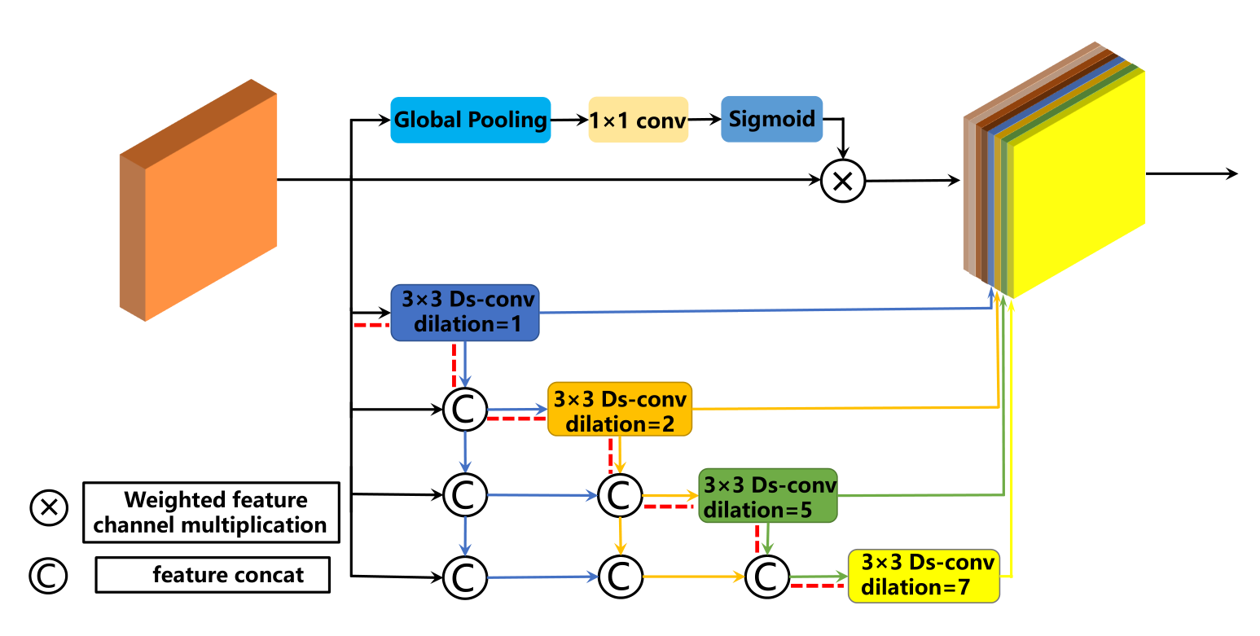
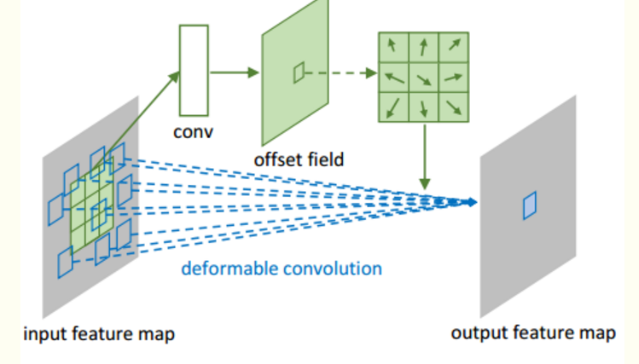
Motivation 2-Ladder ASPP
Contributions：
1.Densely connected spatial pyramid pooling.
2. Separate convolution is used for Ladder-ASPP to achieve model compression.
Channel attention mechanism is ued for Ladder-ASPP.
The block of Ladder-ASPP

Slide 17
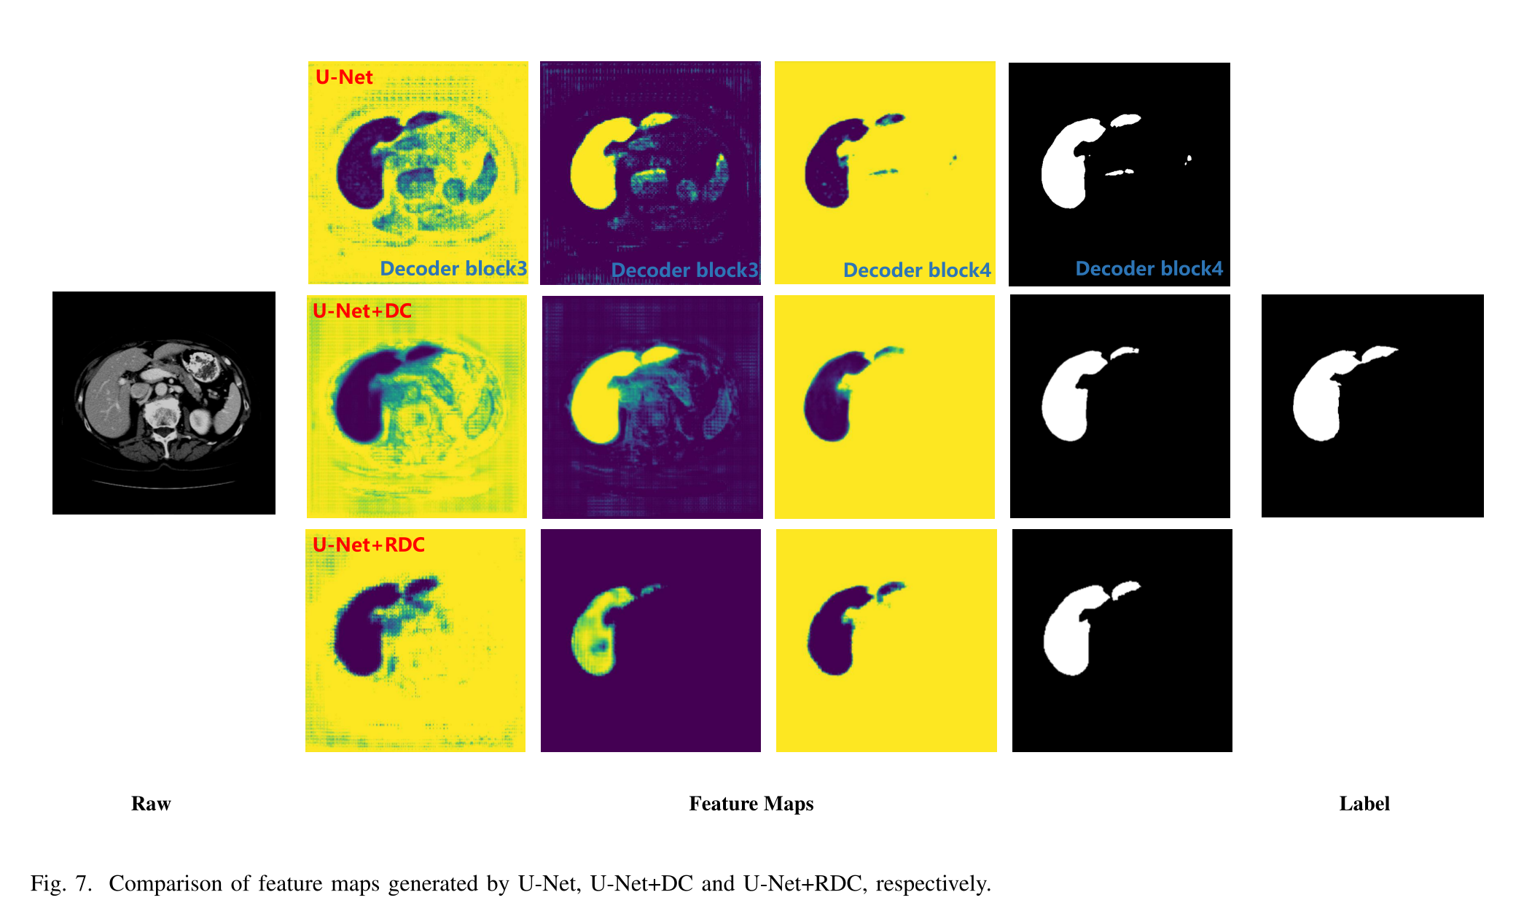
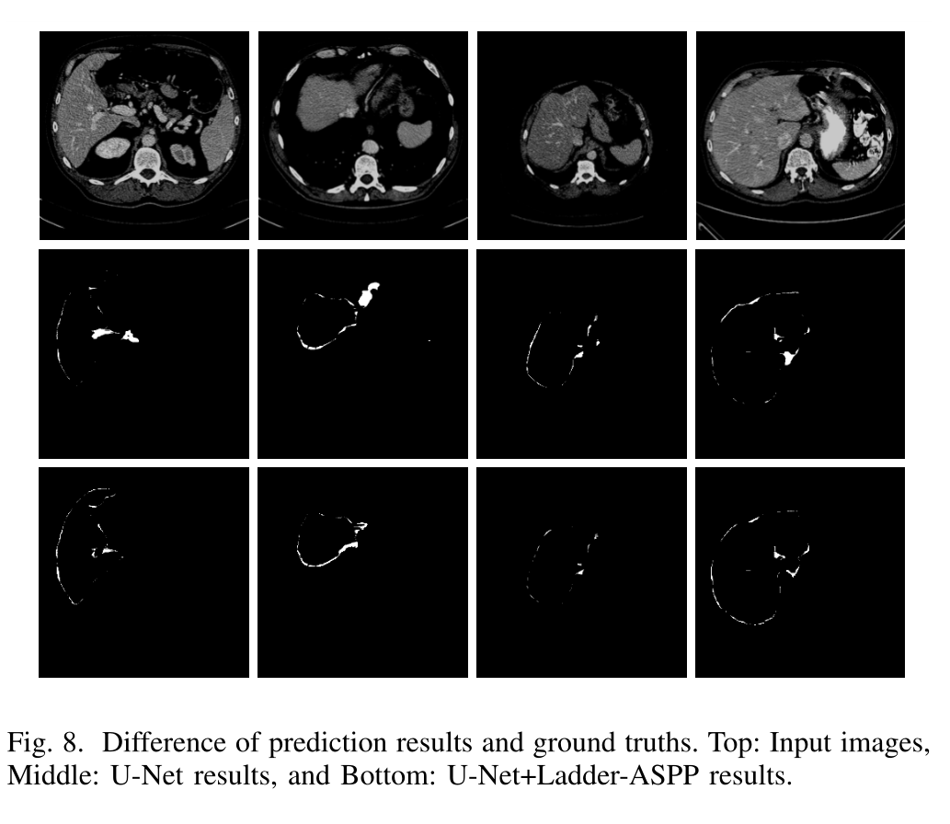
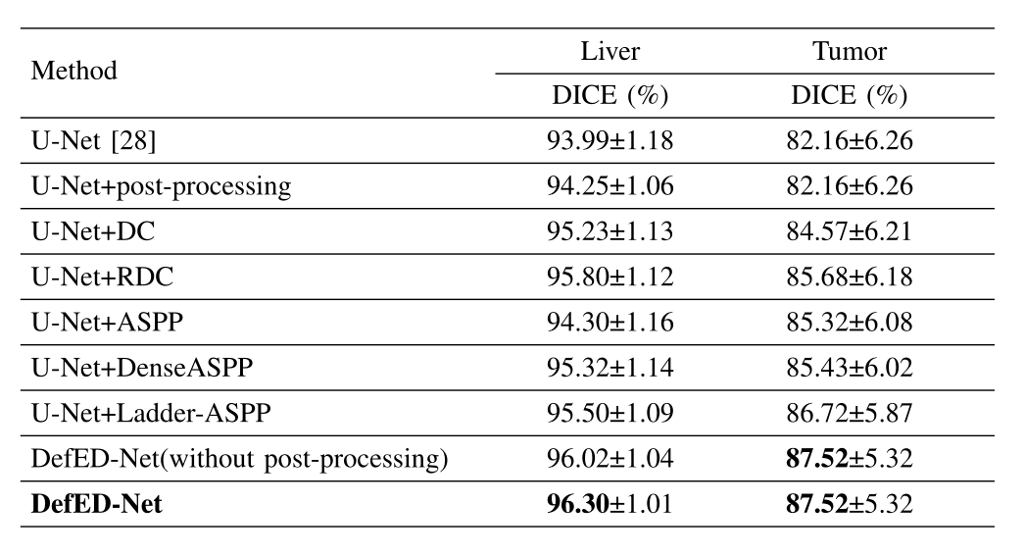
Ablation Studies
RDC can help the network converge faster and obtain more accurate edge predictions.
The residual design not only speeds up the convergence of U-Net, but also further improves segmentation accuracy.
Ladder-ASPP uses atrous convolution with variable dilation rate and dense connection to obtain better context information than ASPP .

Slide 18
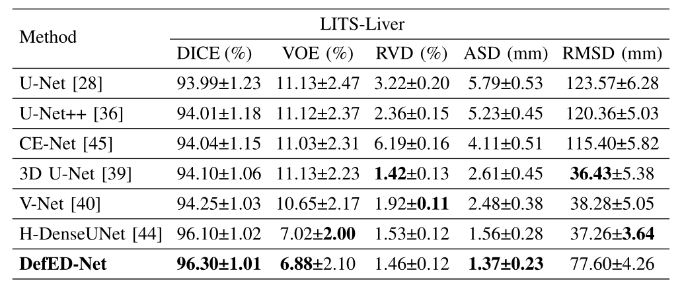
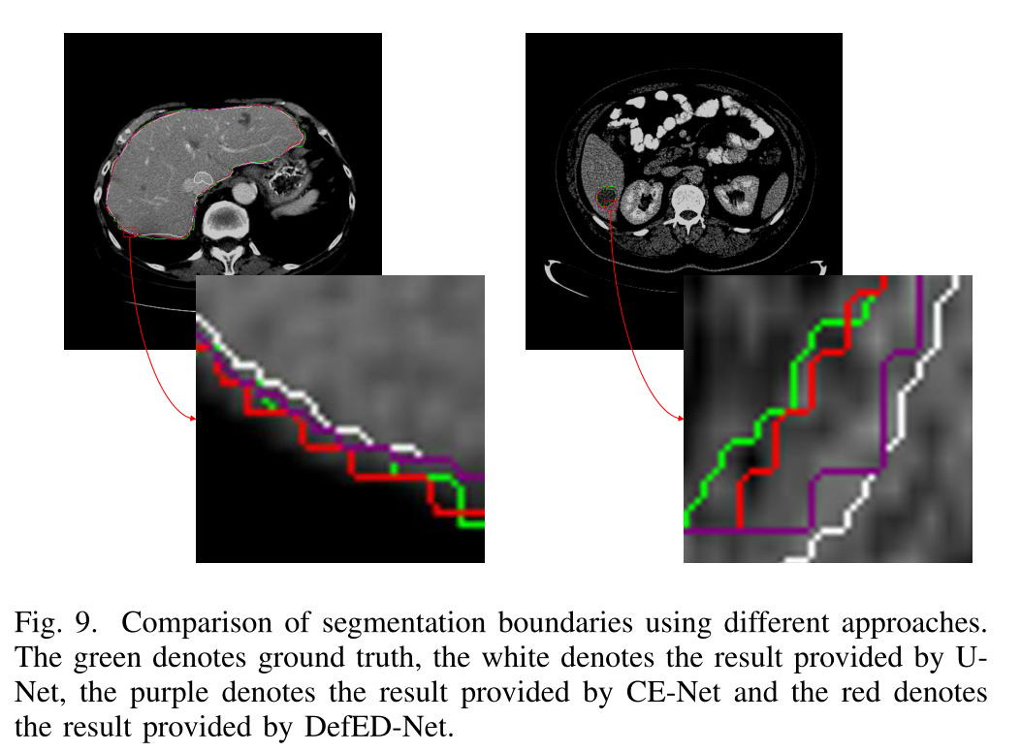
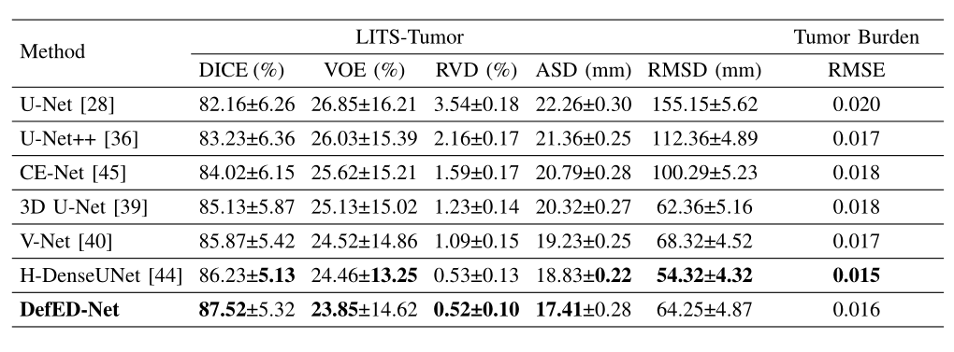
Experimental Comparison on Test Datasets
Advantages: RDC and Ladder-ASPP provide better segmentation results than comparative networks
Disadvantages: DefED-Net requires longer training time due to slow convergence and complex computation.

Slide 19
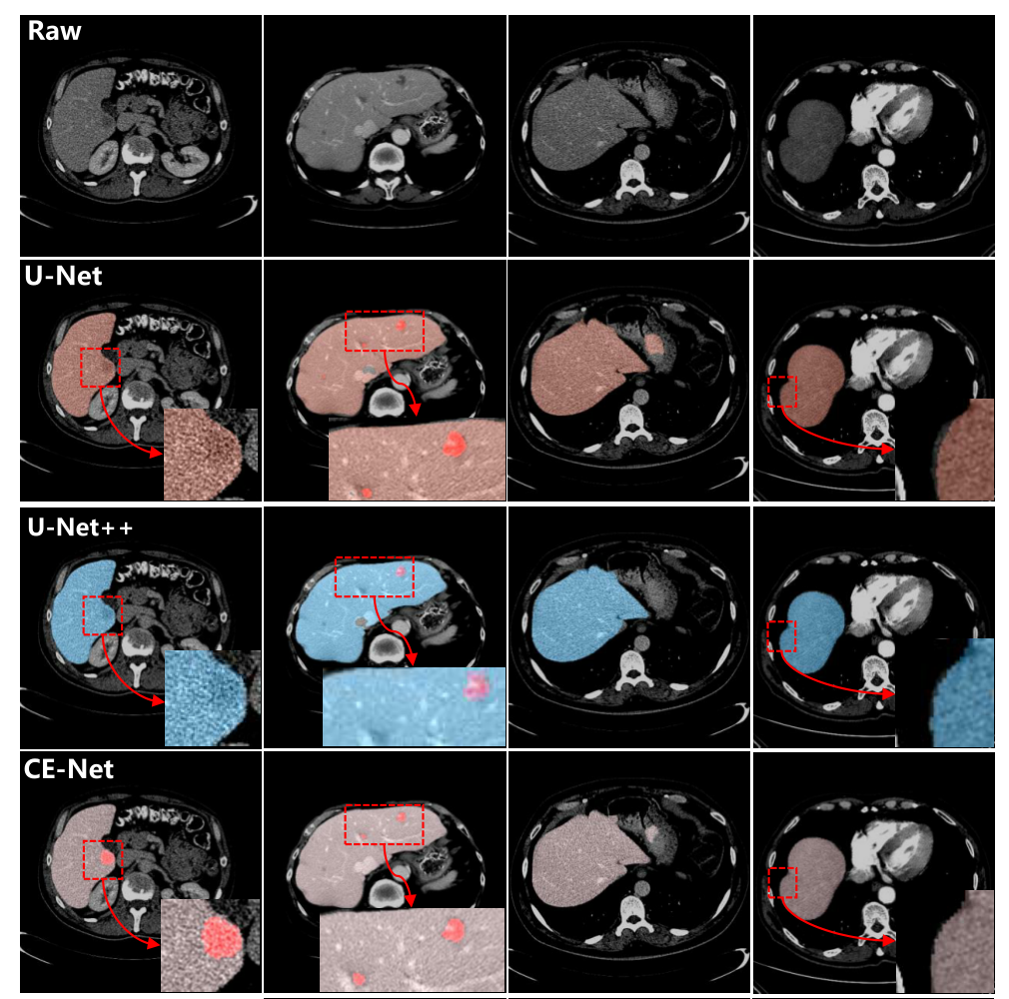
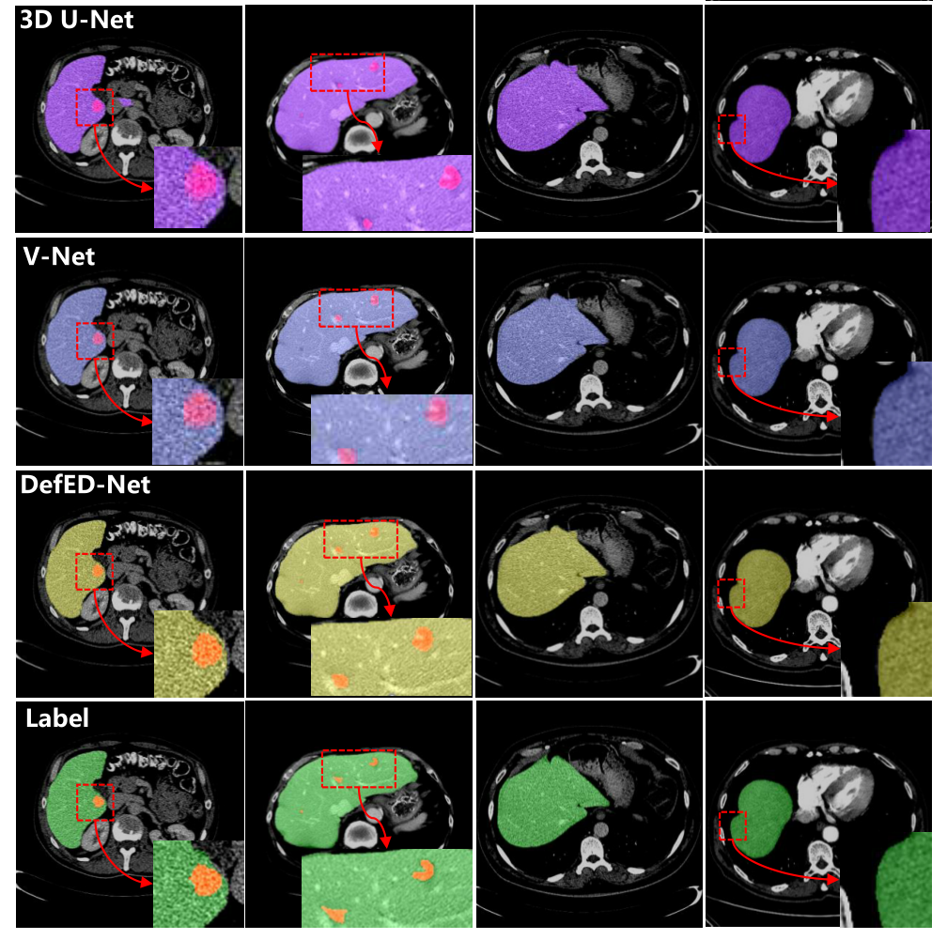
Experimental Comparison on Test Datasets

Slide 20
Contents
1
Backgrounds
2
Related work
3
Method
4
Conclusion

Slide 21
Conclusion
Conclusion:
In the feature extraction we have introduced deformable convolution into U-Nets to achieve better feature encoding.
We have suggested the Ladder-ASPP for feature encoding and fusion. The Ladder-ASPP is superior to ASPP due to the dense connection and atrous convolution with variable dilation rate.
We obtained good performance in liver and liver-tumor segmentation on both the LITS and 3DIRCADb datasets.
Future works:
3D Deformable Convolution.
3D Point Cloud Convolution.
Neural Architecture Search.
Few-shot sample self-supervised learning
Notes:
（页面美化，表达形式重新整理）

Slide 22
Question
Q&A

Slide 23
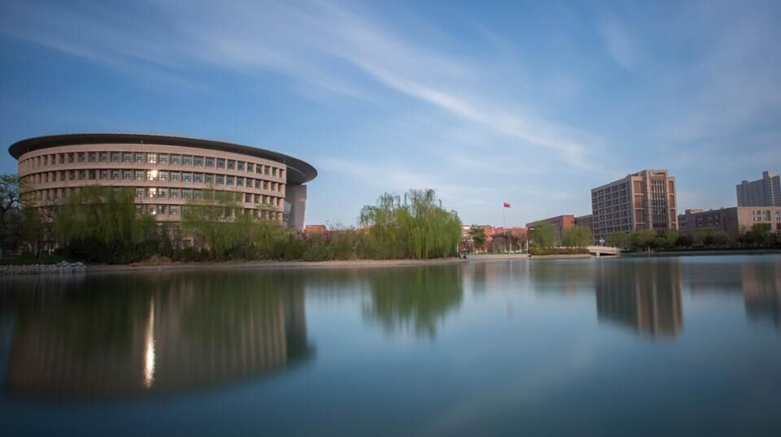
Thank you!
Publication and Available code: https://github.com/SUST-reynole/DefEDNet.

